Slide 1
Table of Contents
jQuery Plugins
Expanding the functionality of jQuery
jQuery Plugins
jQueryUI
Creating Custom Plugins
Implementing chaining
Plugins Options

Slide 2

A Plugin is just a method that extends the jQuery objects prototype
Enabling all jQuery objects to use this method
Once a plugin is imported, it is used as regular jQuery method
Like addClass(), fadeout() and hide()

Slide 3
jQuery has many ready-to-use plugins
A library jQueryUI for UI controls
Plugins for UI
Tabs
$("#tabs-holder").tabs();
Arrangeable elements
$("#grid" ).sortable();
jQuery Plugins – Live Demo

Slide 4
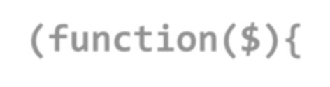







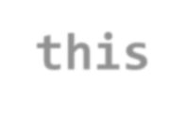



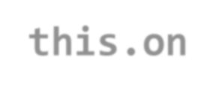

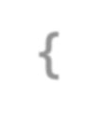

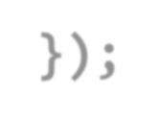





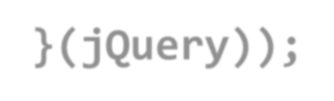
Creating Custom jQuery Plugins
jQuery has an easy way to extend the initial
functionality with plugins
Just create a regular JavaScript method and attach it to jQuery.fn object
(function($){
$.fn.zoom = function(){
var $this = $(this);
$this.on("mouseover", function() {
//zoom in element
});
$this.on("mouseout", function() {
//zoom out element
});
$(".image").zoom();
}
}(jQuery));
Zoom Plugin – Live Demo

Slide 5
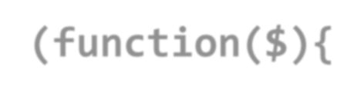





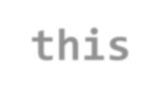



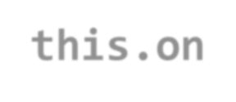




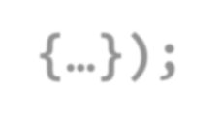




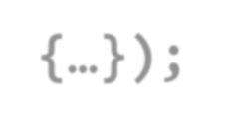
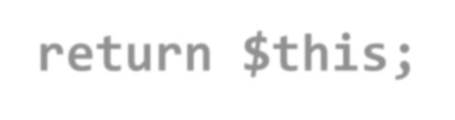

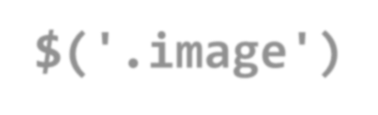
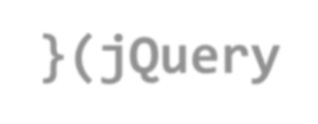
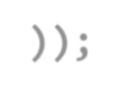



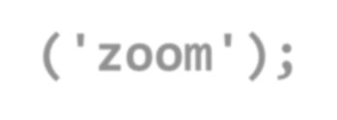
Chaining in Plugins
Chaining is pretty good and useful feature
Better to be implemented in our plugins
Done easy, just return this at the end of the plugin function
(function($){
$.fn.zoom = function(){ var $this = $(this);
$this.on('mouseover', function() {…}ƀ;
$this.on('mouseout', function() {…}ƀ;
return $this;
}
}(jQuery));
$('.image')
.zoom()
.addClass('zoom');
Chaining in Plugins - Live Demo

Slide 6
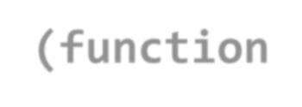
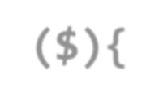









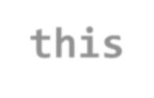



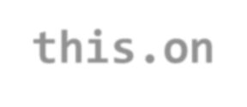



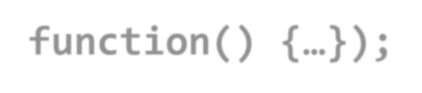



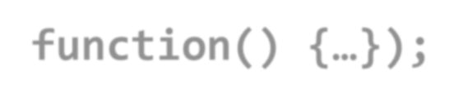



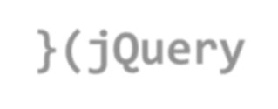
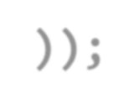
Plugins with Options
Creating plugins more customizable
Plugins can also be provided with options
Just pass regular function parameters
(function($){
//zoom with size percents
$.fn.zoom = function(size){ var $this = $(this);
$this.on('mouseover', functionſƀ {…}ƀ;
$this.on('mouseout', functionſƀ {…}ƀ;
return $this;
}
}(jQuery));
Plugins with Options - Live Demo

Slide 7
Plugins Options
Yet the options sometimes become too many
When too many arguments, just use a options object
Give the options as a JSON-like object
Plugins with Options Object - Live Demo

Slide 8
Homework
Create a jQuery plugin for creating dropdown list
By given the following:
<select id="dropdown">
<option value="1">One</option>
<option value="2">Two</option>
</select>
$('#dropdown').dropdown()
Produces the following HTML:
<select id="dropdown" style="display: none">…</select>
<div class="dropdown-list-container">
<ul class="dropdown-list-options">
<li class="dropdown-list-option" data-value="0">One</li>
…
</ul>
</div>
And make it work as SELECT node
Selecting an one of the generated LI nodes, selects the corresponding OPTION node
So $('#dropdown:selected') works

Slide 9
Homework (2)
*Create a jQuery plugin for fading in/fading out message box
Creates a message box
var msgBox = $('#message-box').messageBox();
Show a success/error message in the box
Showing is done by setting the opacity of the message from 0 to 1 in an interval of 1 second
The message disappears after 3 seconds
msgBox.success('Success message'); msgBox.error('Error message');

